Slide 1
Asian Hornets
Jane Mackridge & Chris Radcliffe

Slide 2
Course Content
Asian and European hornet compared
The Asian hornet
Numbers
What to do
Other countries numbers
What to do if you find an Asian Hornet
Bait station for the AH – plus demonstration
Informing DEFRA
Other resources available

Slide 3
Asian vs European Hornet
European Hornet
1.Some Beekeepers in Europe may keep European hornets and their nests in specially designed boxes hanging on trees, on the premise that the protection they provide against wax moths is worth the occasional bee they may prey upon.
2. European hornets tend to girdle branches, which results in dead branches.
3. European Hornets are protected in Germany - up to a 50,000 euro fine.
Asian Hornet
1. Yellow legs.
2. Single yellow band at base of thorax.
3. Will wipe out a bee hive in a few hours….

Slide 4
Identification

Slide 5
Asian Hornet sightings
  2023 2022 2
Nest(N) and Single(S)
  Jan. to Mar 0 2021 2
  April 1S
  May 2S 2020 1
  June 1N
  July 5N 2019 5
  Aug 37N
  Sept. 23N 2018 9
  Oct. 7N
  Nov. 2N 2017 1
  Dec. 0
  2016. 3
  Total 78
  Note - these have all been in built up areas or next to roads!!

Slide 6
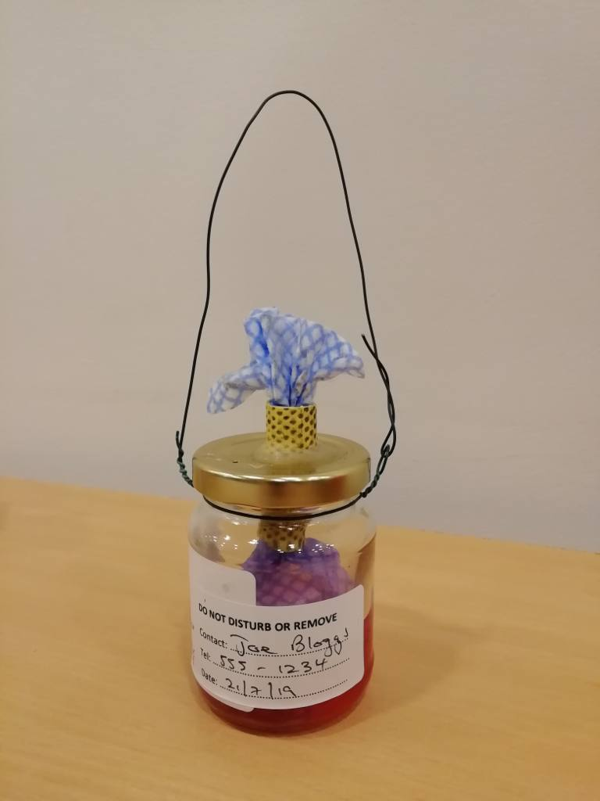
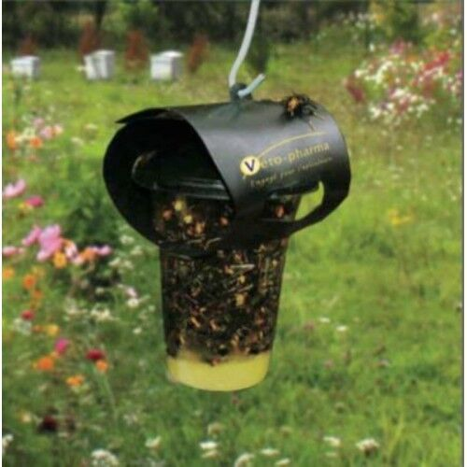
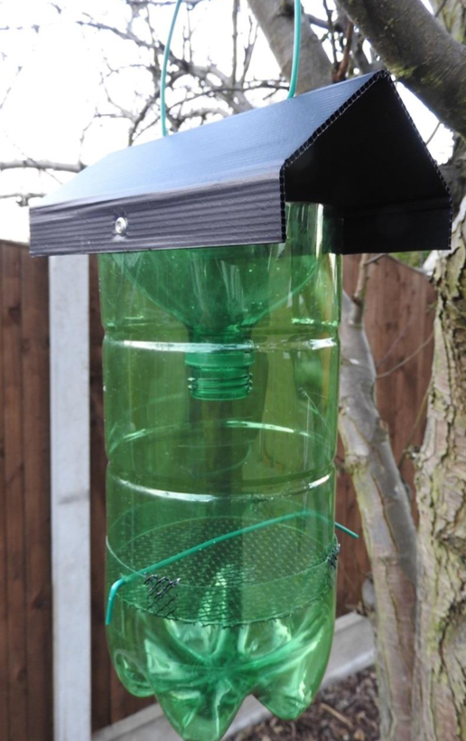
Three simple monitor designs
Honey Jar with wick Commercial trap Plastic inverted bottle
All the designs will need daily monitoring. Report suspect sightings using the
Asian Hornet Watch iPhone or Android app, or by filling out an online report
form.

Slide 7
Asian Hornet Life Cycle
Primary Nest
        Over wintered Queen + up to about 100 workers. End Feb to mid May
Secondary Nest
For larger colony May to July
        Start foraging for nectar (carbs) and insects (protein)
        Up to 6,000 hornets and 150 new queens
Praying On Honey Bees August and September
Up to 30 per day per hornet
Productive males and New Queens (about 150 per nest) leave nest. September and October
Nest slowly dies and newly mated queens find somewhere to hibernate

Slide 8
Using the Asian Hornet trap
Where to hang trap
      In the sun
      But away from your hives - we don’t want to attract the AH
      Near Camellias if you have one
What bait to use
      Beer and red wine
      Cheap strawberry jam and water
      August on use prawns mashed up in water (and hold your nose)
When to use monitor trap
      Feb through to November
Release by catch
      Every few days (as often as is practical)
What to do if you find an Asian hornet
      Shout !!
      Put it in the freezer for 24 hours then photograph
      Report sightings:
    with the iPhone and Android recording app: Asian Hornet Watch
    online at: www.nonnativespecies.org/alerts/asianhornet

Slide 9
Identification video etc.
Asian Hornet Identification Videos
  https://youtu.be/c4DRki97wzg
  https://www.nonnativespecies.org/assets/Uploads/ID_Vespa_velutina_Asian_Hornet_5.0-1.pdf
Other traps.
  The electric harp, the JaBeProDe, Honey jar and wick, and many others
    look online.
Become an Asian Hornet monitor.
  Your country needs you…..
And how to build an Asian Hornet Trap (What we will do now - sort of!)
  https://www.youtube.com/watch?v=CR6MUekAjMo

